Slide 1
Engine room
Dredge pump room
Rudder propeller room
Hydraulic room
Switchboard room
Main deck (port & stbd)
Forward machinery space
Forecast deck
Mess room
Bridge

Slide 2
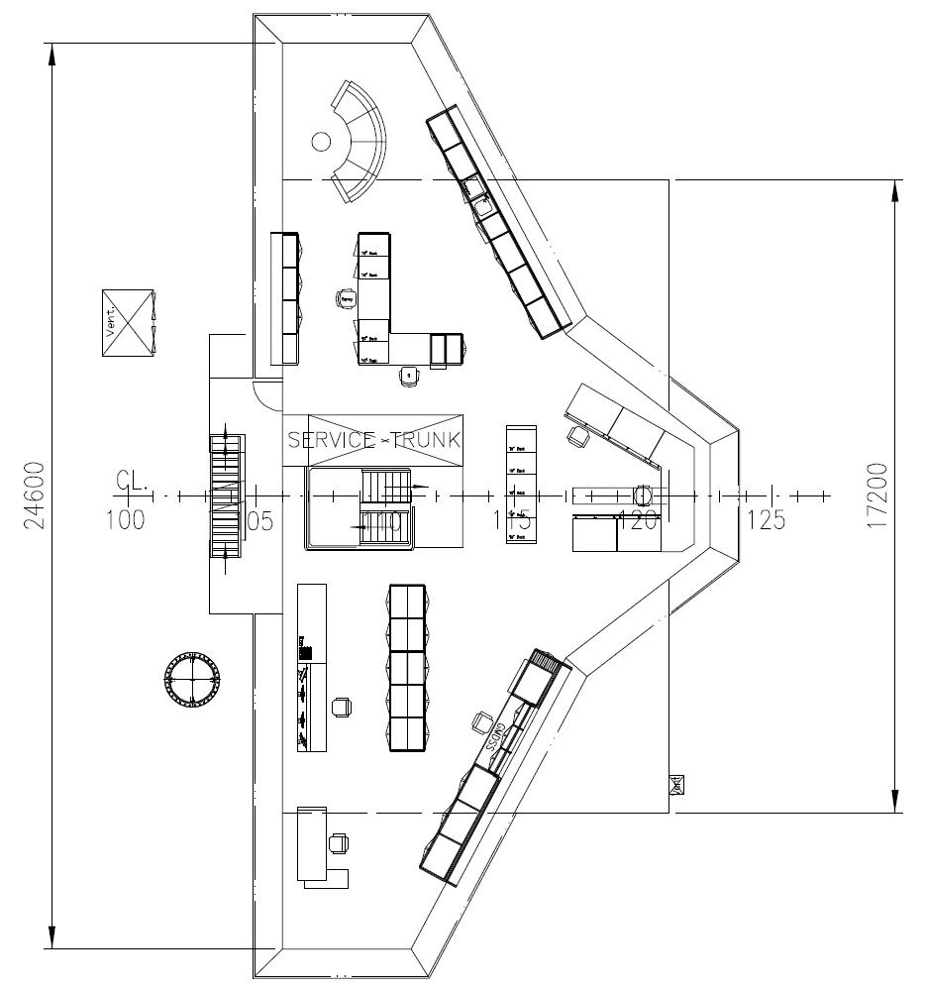
10

Slide 3
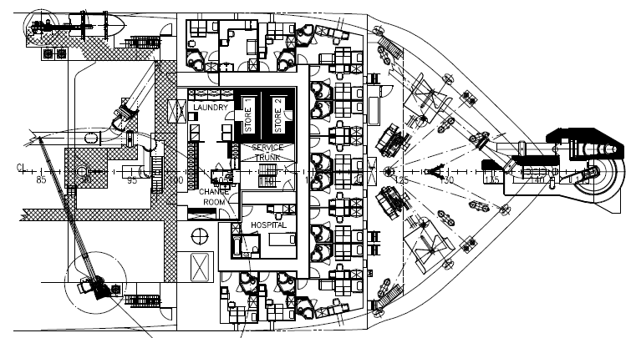
8

Slide 4
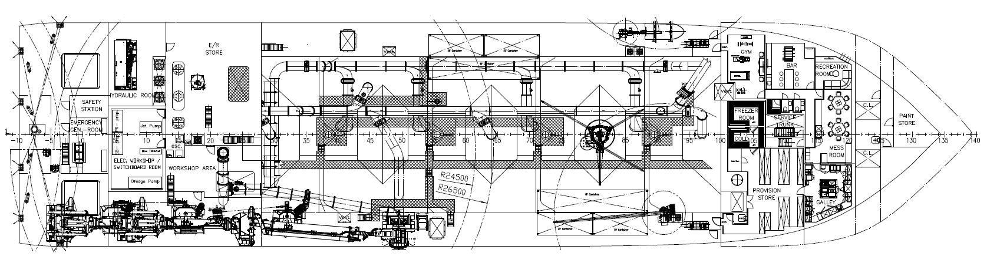
6
4
9
5
6

Slide 5
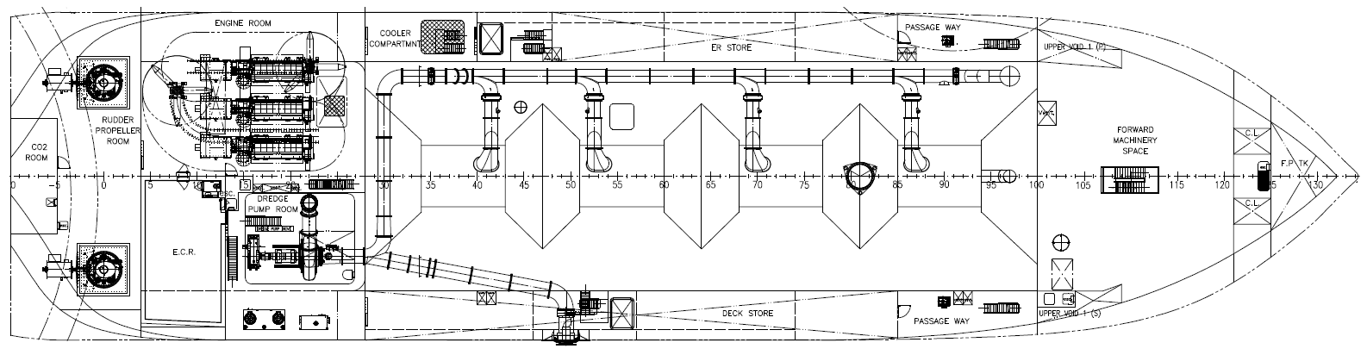
1
7
3
2

Slide 6
